Slide 1


Daria Solodey
Methodist, English teacher, course creator

Slide 2
🔥
Our goal
Pass a job interview
Our rules:
Turn on your camera
Set up your microphone
Be active
Notes:
Если вам не хватило места, вы можете здесь написать развернутый комментарий.

Slide 3

Do you agree with the quote? Why (not)?
“Technology is best when it brings people together.”
― Matt Mullenweg, CEO of Automattic
Useful vocabulary:
As far as I'm concerned…
In my opinion… / To my mind… /
I believe…
Frankly speaking…
Besides…

Slide 4

Lesson Plan:
Study IT jobs
Practice answering the question:
What are your salary expectations?
Notes:
Развернутый комментарий.

Slide 5

What jobs related to IT do you know?
What are people in these positions in charge of?
Let's study and then practise
new words! (1-2)
Check yourself and get more ideas!

Slide 6
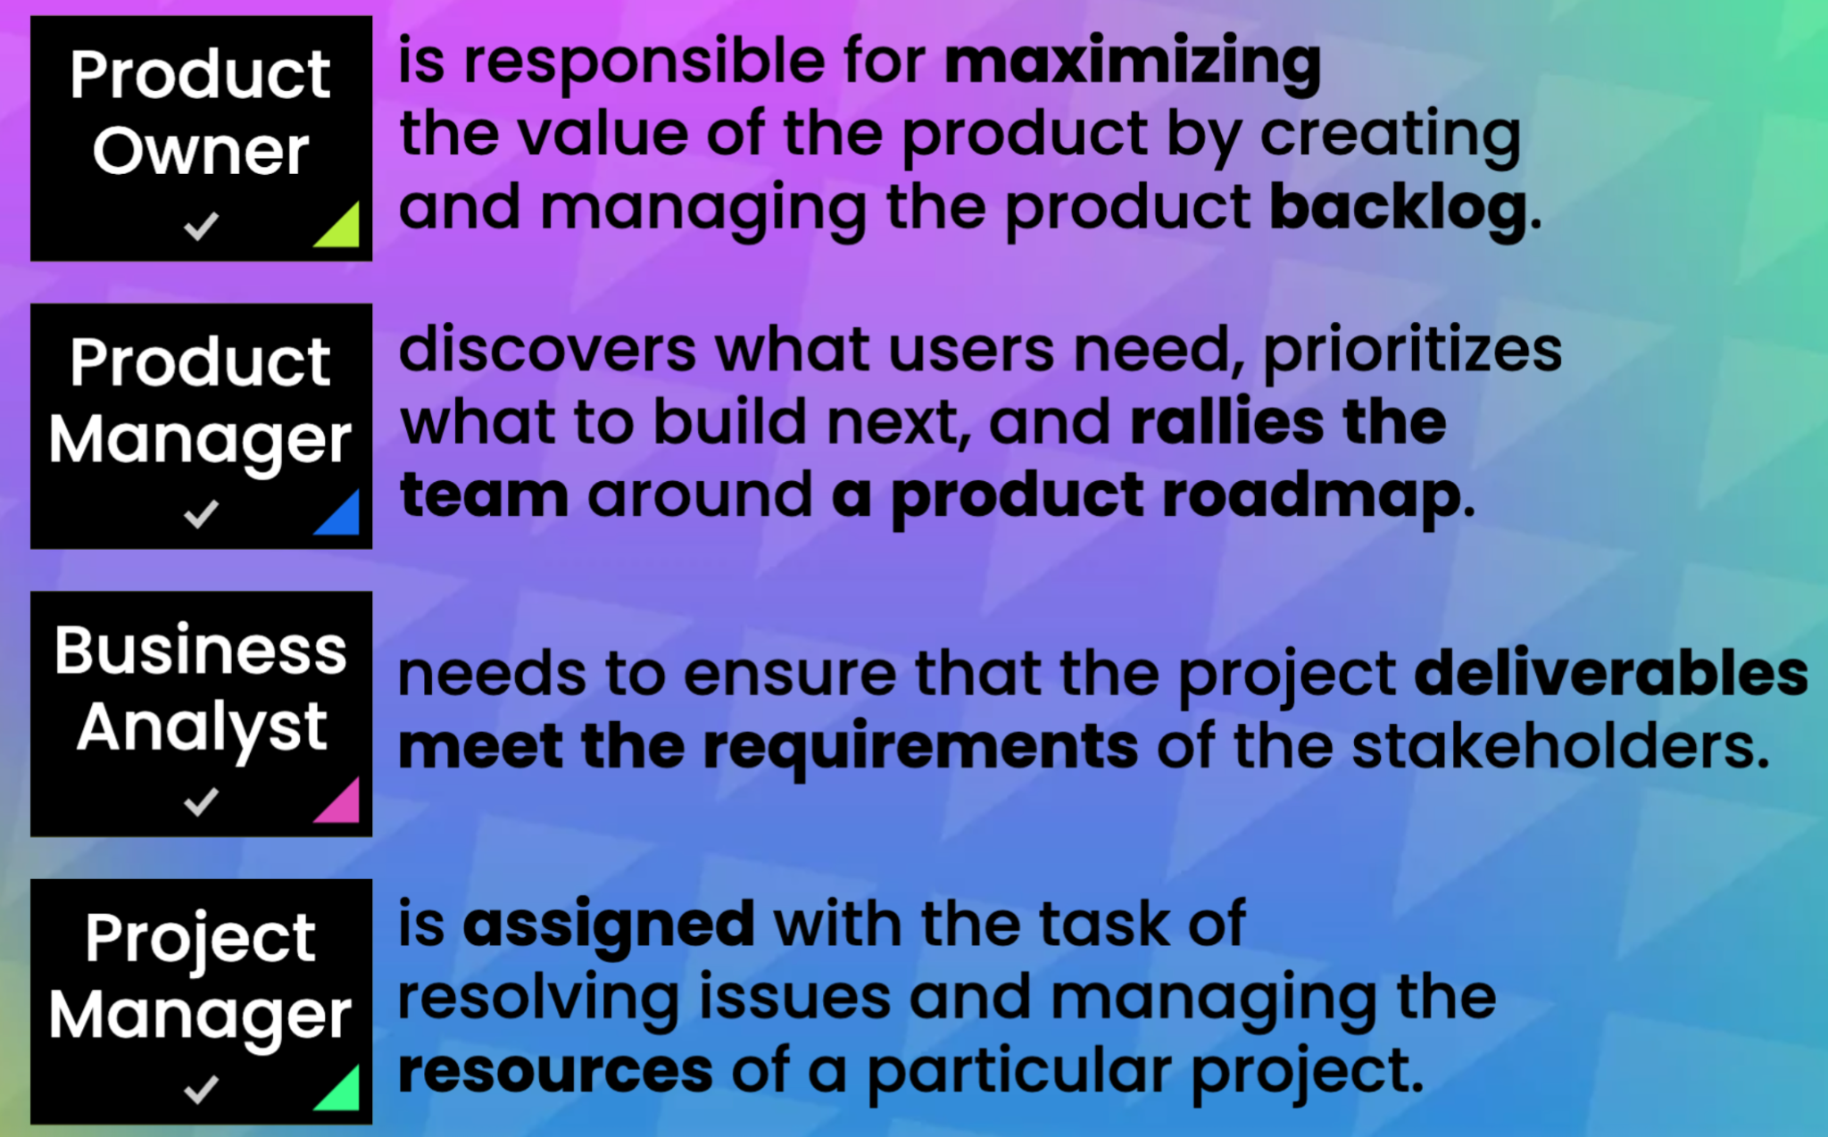
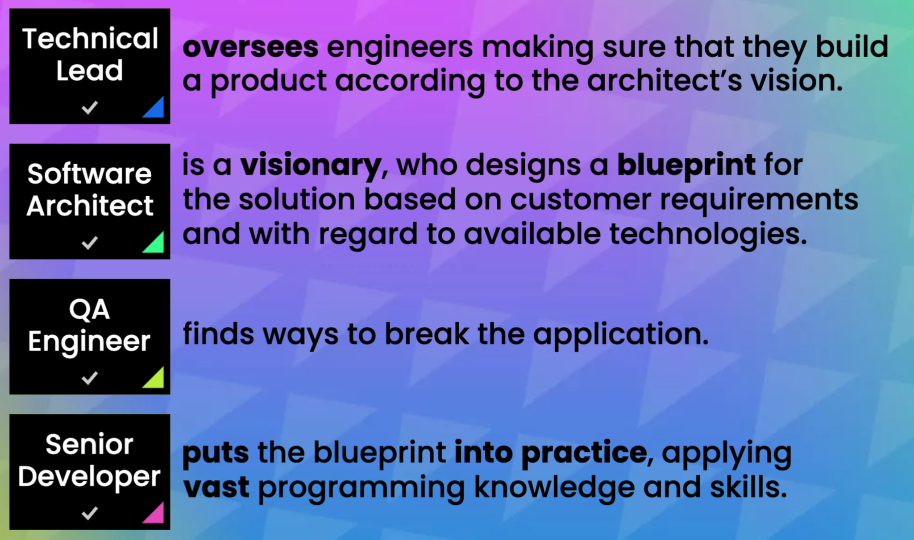
Which of these jobs are most likely to be in demand in future? Why?
If you could work in one of these positions for one day, which one would you choose? Why?

Slide 7

Why do IT professionals earn a lot more than people with traditional jobs (teachers, doctors, engineers)?
Is salary important for you at the beginning of your career? Why (not)?
What other perks/compensation would you like to have?
What's the minimum amount of money you need each month to keep your financial life afloat?
Is it good to start speaking about salary first? Why (not)?

Slide 8
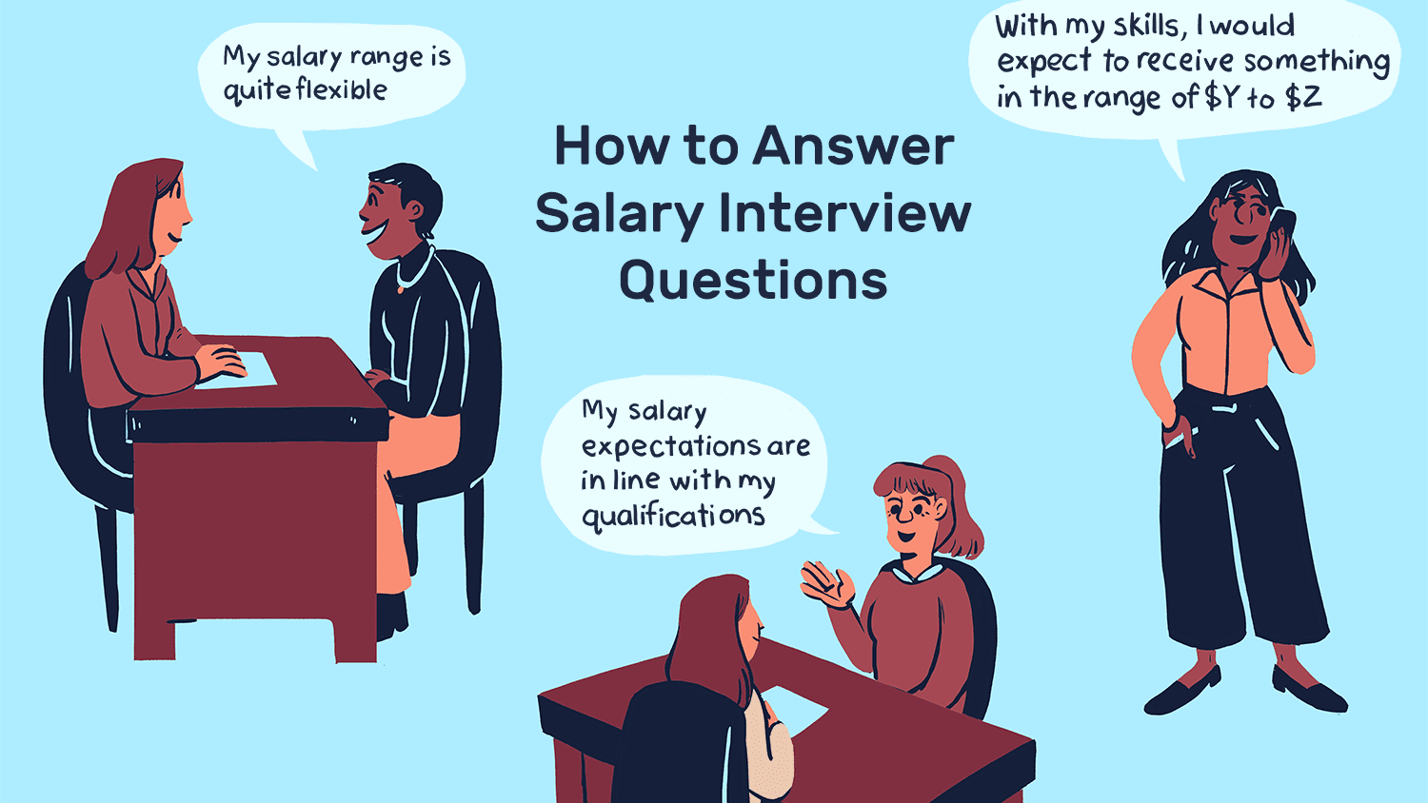
Take a look at the examples of how to answer the questions about salary.
What is important to say?

Slide 9

What the video and try to guess if the statements are true or false
You have to be the first to speak about a salary.
Name an exact amount of money you want to receive.
A set amount can give off the impression that you are open to negotiations.
By giving a salary range, you show that you are flexible and open to discussing.
Employers may ask this question to get a sense of whether or not they can afford your help and see how much you value yourself and your work.

Slide 10
What are your salary expectations?
You have to be the first to speak about a salary. F
Name an exact amount of money you want to receive.
A set amount can give off the impression that you are open to negotiations.
By giving a salary range, you show that you are flexible and open to discussing.
Employers may ask this question to get a sense of whether or not they can afford your help and see how much you value yourself and your work.

Slide 11
What are your salary expectations?
You have to be the first to speak about a salary. F
Name an exact amount of money you want to receive. F
A set amount can give off the impression that you are open to negotiations. F
By giving a salary range, you show that you are flexible and open to discussing.
Employers may ask this question to get a sense of whether or not they can afford your help and see how much you value yourself and your work.

Slide 12
What are your salary expectations?
You have to be the first to speak about a salary. F
Name an exact amount of money you want to receive. F
A set amount can give off the impression that you are open to negotiations.
By giving a salary range, you show that you are flexible and open to discussing.
Employers may ask this question to get a sense of whether or not they can afford your help and see how much you value yourself and your work.

Slide 13
What are your salary expectations?
You have to be the first to speak about a salary. F
Name an exact amount of money you want to receive. F
A set amount can give off the impression that you are open to negotiations. F
By giving a salary range, you show that you are flexible and open to discussing.
Employers may ask this question to get a sense of whether or not they can afford your help and see how much you value yourself and your work.

Slide 14
What are your salary expectations?
You have to be the first to speak about a salary. F
Name an exact amount of money you want to receive. F
A set amount can give off the impression that you are open to negotiations. F
By giving a salary range, you show that you are flexible and open to discussing. T
Employers may ask this question to get a sense of whether or not they can afford your help and see how much you value yourself and your work.

Slide 15
What are your salary expectations?
You have to be the first to speak about a salary. F
Name an exact amount of money you want to receive. F
A set amount can give off the impression that you are open to negotiations. F
By giving a salary range, you show that you are flexible and open to discussing. T
Employers may ask this question to get a sense of whether or not they can afford your help and see how much you value yourself and your work. T

Slide 16
What are your salary expectations?
“I know the average salary for this type of entry-level position is in the $600-$900 range. I think that I would be a great fit for the role due to my skills and knowledge, so I am expecting a salary within that range.”
“Based on my research and with my experience and specific skills in JavaScript and CSS, I would expect to receive something in the range of $600 to $900. However, I am willing to be flexible as I am really interested in working for your company in this role.”

Slide 17

Answer the question:
What are your salary expectations?
Gross or net?
I know the average salary for… is in the… range
Based on… I would expect to receive something in the range of…

Slide 18

What can you do after this lesson?
I learned:
IT jobs
How to answer the question:
What are your salary expectations?
Notes:
Развернутый комментарий

Slide 19
Useful links:
Games:
https://wordwall.net/resource/35543252/it-vocabulary - new words with meanings
https://wordwall.net/ru/resource/35555495 - practice
https://wordwall.net/resource/35529739/architect-developer-tech-lead-qa - jobs
https://wordwall.net/resource/35529786/product-manager-product-owner-project-manager-business-analyst - jobs

Slide 20
Thank you!

